Slide 1
Chapter 13 Lecture 8
Md. Akhtaruzzaman Adnan

Slide 2
LAN
The LAN market has seen several technologies such as Ethernet, Token Ring, Token Bus, FDDI, and ATM LAN. Some of these technologies survived for a while, but Ethernet is by far the dominant technology.

Slide 3
STANDARD ETHERNET
MAC Sublayer
In Standard Ethernet, the MAC sub layer governs the operation of the access method. It also frames data received from the upper layer and passes them to the physical layer.

Slide 4
Frame Format
The Ethernet frame contains seven fields:
preamble,
SFD,
DA,
SA,
length or type of protocol data unit (PDU),
upper-layer data,
and the CRC.

Slide 5
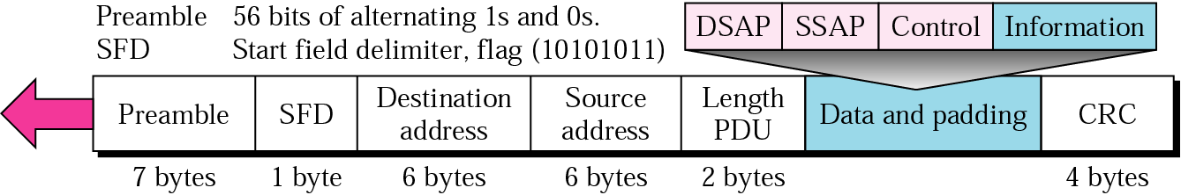
802.3 MAC frame

Slide 6
Preamble
The first field contains 7 bytes (56 bits) of alternating 0s and 1s that alerts the receiving system to the coming frame and enables it to synchronize its input timing.
The pattern provides only an alert and a timing pulse.
The preamble is actually added at the physical layer and is not (formally) part of the frame.

Slide 7
Start frame delimiter (SFD)
The second field (l byte: 10101011)
Signals the beginning of the frame.
The SFD warns the station or stations that this is the last chance for synchronization.
The last 2 bits is 11 and alerts the receiver that the next field is the destination address.

Slide 8
Destination address (DA)
The DA field is 6 bytes and contains the physical address of the destination station or stations to receive the packet.

Slide 9
Source address (SA)
The SA field is also 6 bytes and contains the physical address of the sender of the packet.

Slide 10
Length or type
This field is defined as a type field or length field.
The IEEE standard used it as the length field to define the number of bytes in the data field.

Slide 11
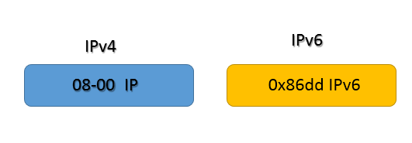
Modern LAN implementations mostly use the IP protocol in the network layer. There are two variants of the IP protocol; IPv4 and IPv6.
If the type field has value IP or ox800, the frame is carrying the data of the IPv4 protocol. If the type field has value IPv6 or 0x86dd, the frame is carrying the data of the IPv6 protocol.
The following image shows an example of the type field for both IP variants.

Slide 12
Data
This field carries data encapsulated from the upper-layer protocols.
It is a minimum of 46 and a maximum of 1500 bytes

Slide 13
CRC cyclic redundancy check Also known as FCS (Frame Check Sequence)
This field is 4 bytes long. This field stores a 4 bytes value that is used to check whether the received frame is intact or not.
The sender device takes all fields of the frame except the FCS field, and runs them through an algorithm, known as the CRC (Cyclic Redundancy Check). The CRC algorithm generates a 4-byte result, which is placed in this FCS field.
When the destination device receives a frame, it takes the same fields and runs them through the same algorithm. If the result matches with the value stored in the FCS field, the frame is considered good and is processed further.
If both values do not match, the frame is considered bad and is dropped.

Slide 14
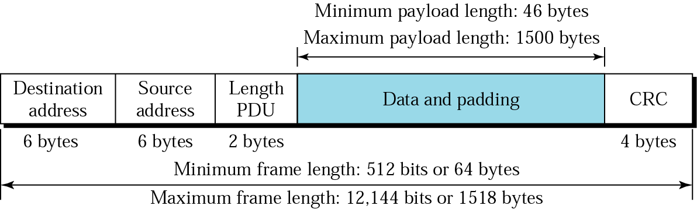
Frame Length
Ethernet has imposed restrictions on both the minimum and maximum lengths of a frame

Slide 15
Minimum length of frame
The minimum length restriction is required for the correct operation of CSMAlCD.
An Ethernet frame needs to have a minimum length of 512 bits or 64 bytes.
Part of this length is the header and the trailer.
If we count 18 bytes of header and trailer (6 bytes of source address, 6 bytes of destination address, 2 bytes of length or type, and 4 bytes of CRC), then the minimum length of data from the upper layer is :
64 - 18 = 46 bytes
If the upper-layer packet is less than 46 bytes, padding is added to make up the difference.

Slide 16
Max length of frame
The standard defines the maximum length of a frame (without preamble and SFD field) as 1518 bytes. If we subtract the 18 bytes of header and trailer, the maximum length of the payload is 1500 bytes.

Slide 17
The maximum length restriction has two historical reasons:
First, memory was very expensive when Ethernet was designed: a maximum length restriction helped to reduce the size of the buffer.
Second, the maximum length restriction prevents one station from monopolizing the shared medium, blocking other stations that have data to send.

Slide 18
CRC calculation
See attached file

Slide 19

Addressing
Each station on an Ethernet network (such as a PC, workstation, or printer) has its own network interface card (NIC).
The NIC fits inside the station/PC and provides the station with a 6-byte physical address.
As shown in here, the Ethernet address is 6 bytes (48 bits), normally written in hexadecimal notation, with a colon between the bytes.
6 bytes =12 hex digits =48 bits

Slide 20
Unicast, Multicast, and Broadcast Addresses
A source address is always a unicast address-the frame comes from only one station.
The destination address, however, can be unicast, multicast, or broadcast.

Slide 21
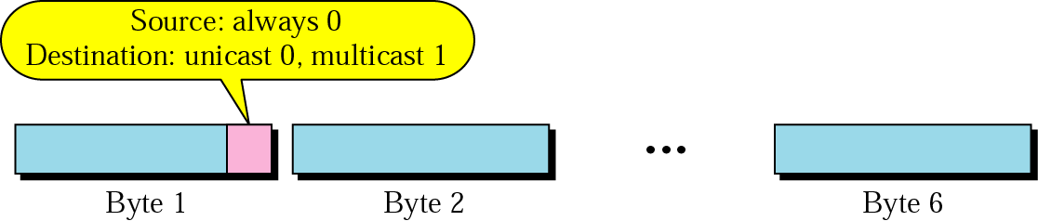
Figure shows how to distinguish a unicast address from a multicast address.
If the least significant bit of the first byte in a destination address is 0, the address is unicast; otherwise, it is multicast.

Slide 22
A unicast destination address defines only one recipient; the relationship between the sender and the receiver is one-to-one.
A multicast destination address defines a group
of addresses; the relationship between the sender and the receivers is one-to-many.
The broadcast address is a special case of the multicast address; the recipients are all the stations on the LAN.
A broadcast destination address is forty-eight 1’s.

Slide 23
Define the type of the following destination addresses:
a. 4A:30:10:21:1O:1A
b. 47:20:1B:2E:08:EE
c. FF:FF:FF:FF:FF:FF

Slide 24
Solution
To find the type of the address, we need to look at the second hexadecimal digit from the left.
If it is even, the address is unicast.
If it is odd, the address is multicast.
If all digits are F's, the address is broadcast.

Slide 25
a. 4A:30:10:21:1O:1A
b. 47:20:1B:2E:08:EE
c. FF:FF:FF:FF:FF:FF
a. This is a unicast address because A in binary is 1010 (even).
b. This is a multicast address because 7 in binary is 0111 (odd).
c. This is a broadcast address because all digits are F's (1111).

Slide 26
Solve it and put your result in chat box
1. 2B:30:10:21:1O:1A
2. 1C:A0:1B:2E:08:EE
3. 4E:A1:BB:BA:AC:22

Slide 27
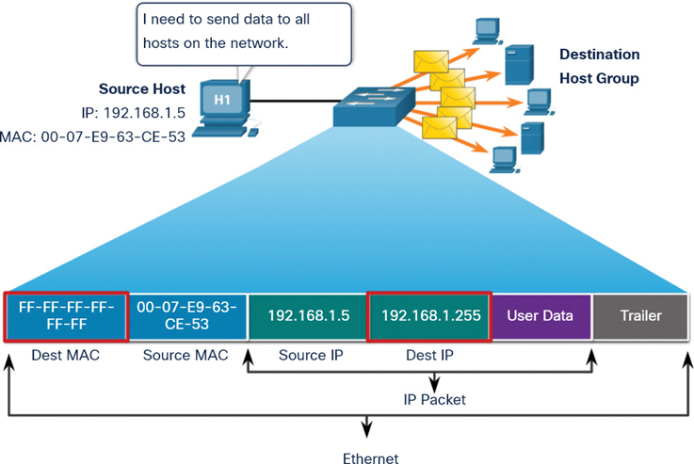
The way the addresses are sent out on line is different from the way they are written in hexadecimal notation.
The transmission is left-to-right, byte by byte; however, for each byte, the least significant bit is sent first and the most significant bit is sent last.
This means that the bit that defines an address as unicast or multicast arrives first at the receiver.

Slide 28
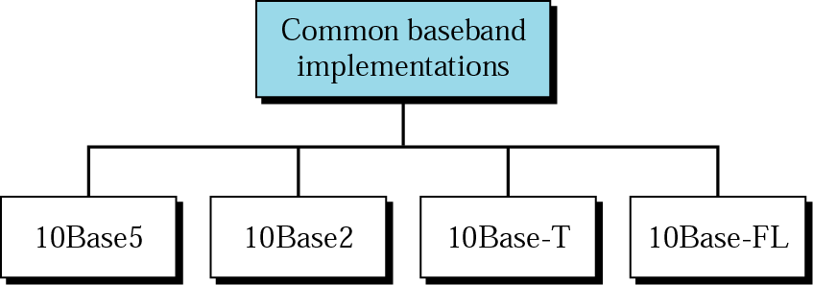
Physical Layer
The Standard Ethernet defines several physical layer implementations; four of the most
common

Slide 29
10Base5: Thick Ethernet
The first implementation is called 10Base5, thick Ethernet, or Thicknet.
The 10 refers to its transmission speed of 10 Mbit/s. The BASE is short for baseband signalling , and the 5 stands for the maximum segment length of 500 metres .
10Base5 was the first Ethernet specification to
use a bus topology with an external transceiver (transmitter/receiver) connected via a tap to a thick coaxial cable.

Slide 30
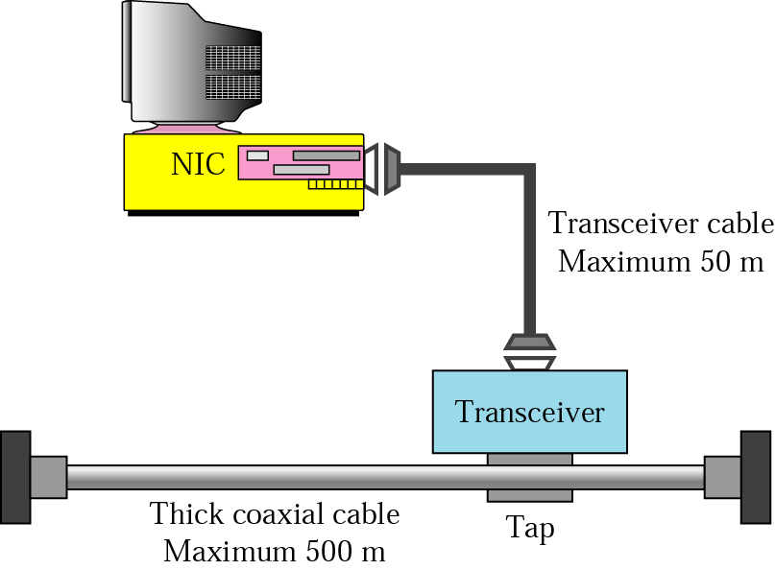

Slide 31
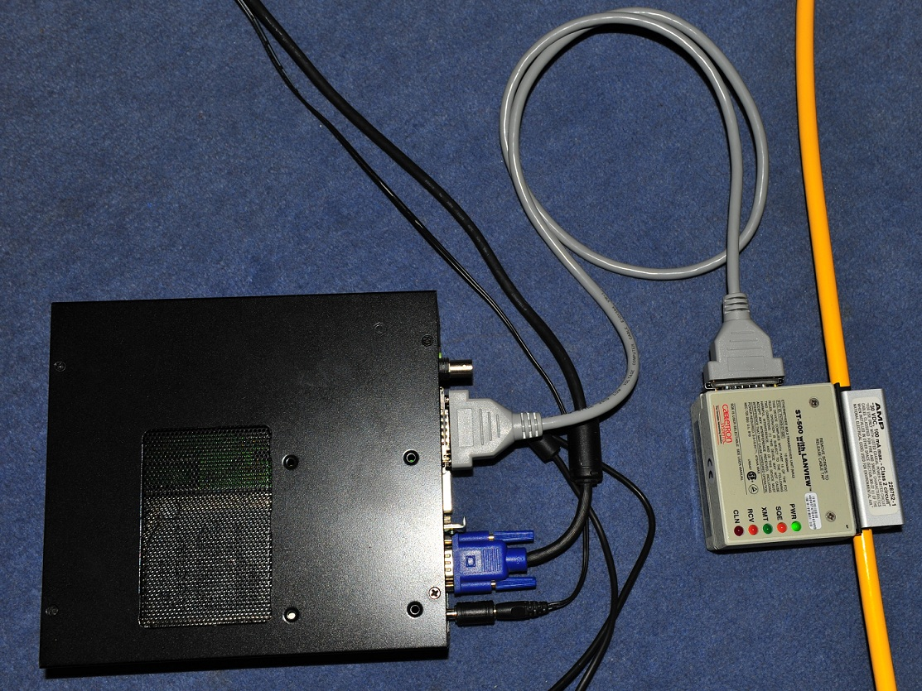

Slide 32
10Base2: Thin Ethernet
The second implementation is called 10Base2, thin Ethernet, or Cheapernet.
10Base2 also uses a bus topology, but the cable is much thinner and more flexible.
The cable can be bent to pass very close to the stations. In this case, the transceiver is normally part of the network interface card (NIC), which is installed inside the station

Slide 33
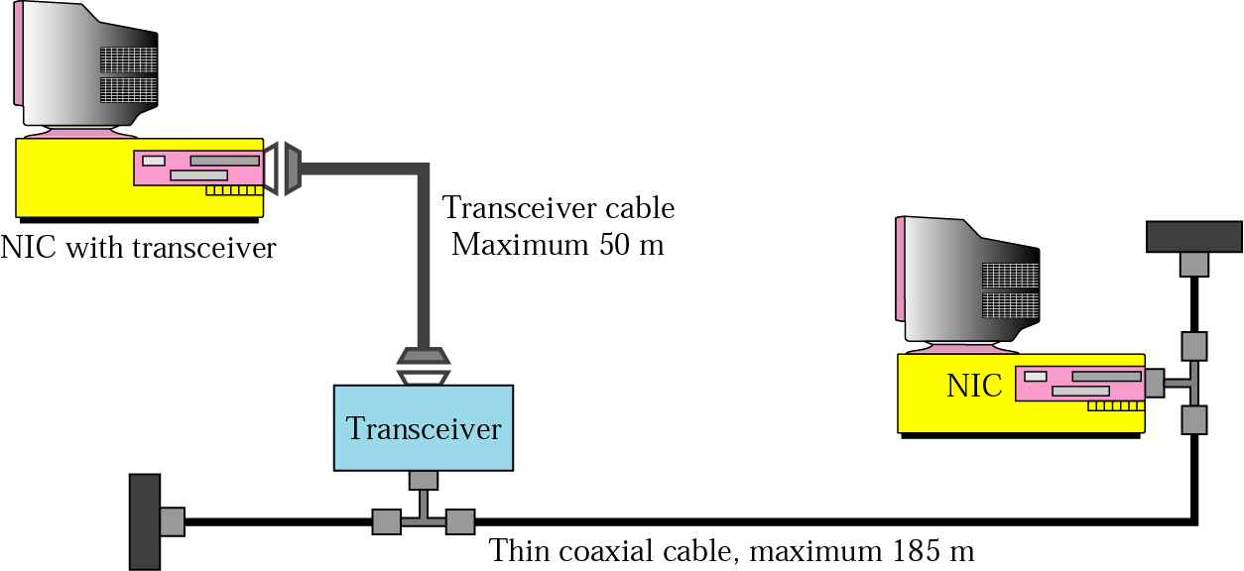

Slide 34
The 10 comes from the maximum transmission speed of 10 Mbit/s. The BASE stands for baseband signalling, and the 2 supposedly refers to the maximum segment length of 200 meters, though in practical use it can only run up to 185 meters

Slide 35
10Base2 vs 10Base5
10Base2 is more cost effective than 10Base5 because thin coaxial cable is less expensive than thick coaxial and the tee connections are much cheaper than taps. Installation is simpler because the thin coaxial cable is very flexible.

Slide 36
During the mid to late 1980s 10BASE2 and 10BASE5 these were the dominant 10 Mbit/s Ethernet standard
But due to the immense demand for high speed networking, the low cost of Category 5 Ethernet cable, and the popularity of 802.11 wireless networks, both 10BASE2 and 10BASE5 have become increasingly obsolete, though they still exist in some locations.

Slide 37
10Base-T: Twisted-Pair Ethernet
The third implementation is called 10Base-T or twisted-pair Ethernet.
10Base-T uses a physical star topology. The stations are connected to a hub via two pairs of twisted cable.

Slide 38
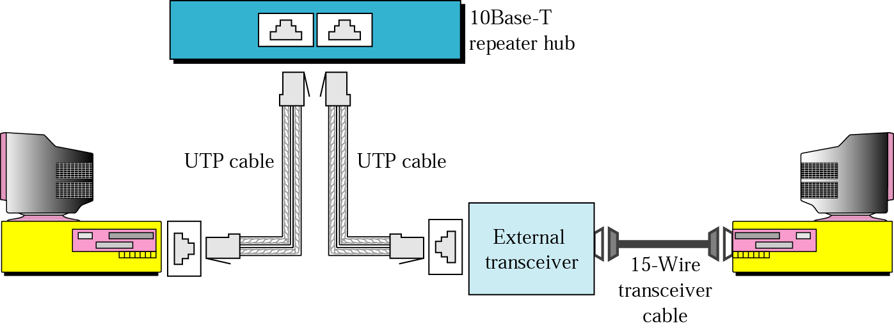

Slide 39
10Base-FL: Fibre Link Ethernet
Although there are several types of optical fiber 10-Mbps Ethernet, the most common is
called 10Base-FL.
10Base-FL uses a star topology to connect stations to a hub.
The stations are connected to the hub using two fibre-optic cables.

Slide 40
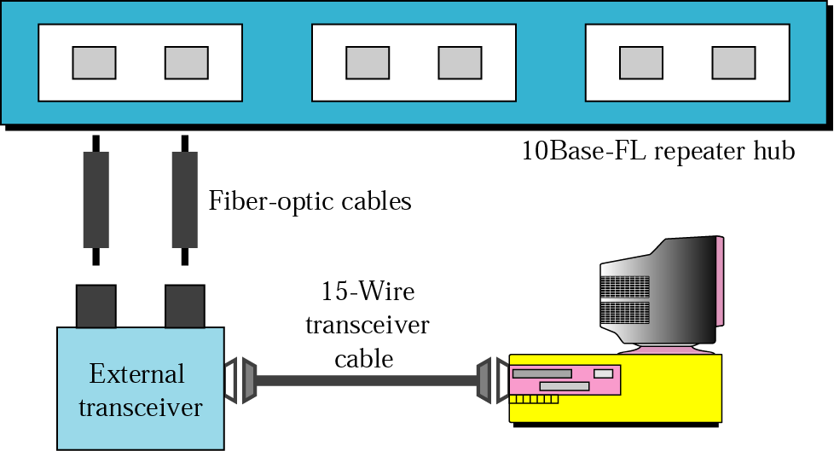

Slide 41
The use of fibre optic cable provides advantages over copper cables (Ethernet) for multiple reasons.
Fibre optic cable is immune to electrical and magnetic interference so it can be used in high interference environment.
10BASE-FL can reach 2000 meters while 10BASE-T is limited to 100 meters.

Slide 42
FAST ETHERNET
Fast Ethernet was designed to compete with LAN protocols such as FDDI or Fiber Channel.
IEEE created Fast Ethernet under the name 802.3u.
Fast Ethernet is backward-compatible with Standard Ethernet, but it can transmit data 10 times faster at a rate of 100 Mbps.

Slide 43
The goals of Fast Ethernet can be summarized as follows:
1. Upgrade the data rate to 100 Mbps.
2. Make it compatible with Standard Ethernet.
3. Keep the same 48-bit address.
4. Keep the same frame format.
5. Keep the same minimum and maximum frame lengths.

Slide 44
A new feature added to Fast Ethernet is called auto negotiation.
It allows a station or a hub a range of capabilities.
Auto negotiation allows two devices to negotiate the mode or data rate of operation.
It was designed particularly for the following purposes:
To allow incompatible devices to connect to one another. For example, a device with a maximum capacity of 10 Mbps can communicate with a device with a 100 Mbps capacity (but can work at a lower rate).

Slide 45
GIGABIT ETHERNET
The need for an even higher data rate resulted in the design of the Gigabit Ethernet protocol (1000 Mbps).
The IEEE committee calls the Standard 802.3z.
The goals of the Gigabit Ethernet design can be summarized as follows:
1. Upgrade the data rate to 1 Gbps.
2. Make it compatible with Standard or Fast Ethernet.
3. Use the same 48-bit address.
4. Use the same frame format.
5. Keep the same minimum and maximum frame lengths.
6. To support auto negotiation as defined in Fast Ethernet.

